Slide 1
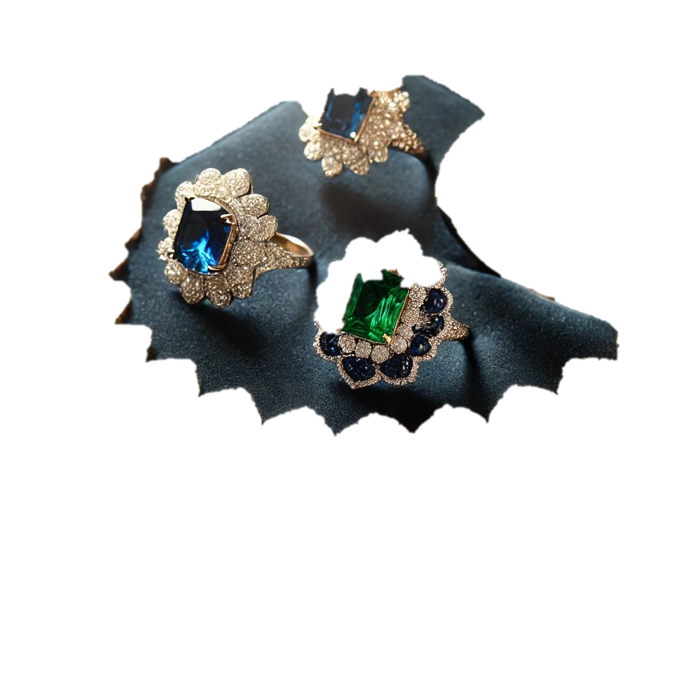
RESEARCH SURVEY
JEWELRY BOUTIQUE IN WUSE 2, ABUJA

Slide 2
Research Objective
STEP 1
Market Demand: Determine if there is need of a jewelry boutique in wuse.
Consumer Preference: Identify the type of jewelry piece people prefer.
Pricing Strategy: Find out how much customers are willing spend on a jewelry.
Business model: Determine if customers prefer order online or visit physical store.

Slide 3
Research Questions
Do people need a jewelry boutique in wuse?
What jewelry piece do people prefer?
How much are people willing to pay?
What is the preferred model?

Slide 4
Designing the Questionnaire
Title: Understanding the need of a jewelry boutique preference in Wuse Abuja
Introduction.
Thank you for participating in this survey. We are researching the possibility of opening a jewelry boutique in Wuse, Abuja, and we would love your feedback. Your response will remain confidential and will help us make important business decisions.

Slide 5
Consent Question
Do you agree to participate in this survey
Yes
No
Eligibility Question (optional)
Do you wear jewelry
Yes
No

Slide 6
Section 1: General Information (Demographic Details)
Age Group
Gender
Do you live or work in Wuse
18-24
25-34
35-44
45-54
55 and above
Male
Female
Prefer not to say
Yes
No

Slide 7
Section 2; Market Demand Objective: To determine if there is demand for a jewelry boutique in wuse
How often do you wear jewelry
Where do you usually get your jewelry
Daily
A few times in a week’
Once a week
Occasionally
Online store
Physical store

Slide 8
Section 3: customer preference & price strategy
What type of jewelry do you prefer?
Neck Jewelry
Hand & Finger Jewelry
Ear Jewelry
Facial & Body Jewelry
Ankle & Foot Jewelry
Brooches & Pin
Watches & Functional Jewelry
What price range would you be comfortable paying for a jewelry
₦50,000 - ₦150,000
₦151,000 - ₦250,000
₦251,000 - ₦550,000
₦551,000 - ₦750,000
Above ₦800,000

Slide 9
Section 5: Business model preferences
Would you prefer shopping online or at a physical store?
I prefer to shop online
I prefer to visit the physical store
If we open a jewelry boutique, what features would you like to experience?
Quality jewelry
Great customer services
Affordable price
Customer incentive

Slide 10
Section 5: Business model preferences
On a scale of 1-5, how interested are you in visiting a new jewelry boutique in Wuse, Abuja?
1 – Not Interested
2 – Slightly Interested
3 – Neutral
4 – Interested
5 – Very Interested

Slide 11
Thank you for your participation! Your responses will help us create a better shopping experience.

Slide 12
ANALYSIS REPORT FOR MARKET SURVEY
JEWELRY BOUTIQUE IN WUSE, ABUJA

Slide 13
INTRODUCTION
After successfully conducting a market survey for our jewelry boutique, this report is to uncover the feasibility of opening a jewelry boutique in Wuse, Abuja.

Slide 14
Objective
Market Demand: Determine if there is need of a jewelry boutique in wuse.
Consumer Preference: Identify the type of jewelry piece people prefer.
Pricing Strategy: Find out how much customers are willing spend on a jewelry.
Business model: Determine if customers prefer order online or visit physical store.

Slide 15
Method & Statistical techniques used
Measures of central tendency: This was used to describe my numerical data such as price and interest question (Mean, Median, Standard deviation).
Measure of Frequency: This was used to describe my categorical data such as age group, Gender, etc.
Chi Square: This was used to find relationships between the variable within the objectives and demographic information
Mann Whitney : This was used to know the difference in price preference by gender

Slide 16
RESULT
AGE
GENDER
LOCATION
18-24 13.3%
25-34 77.8%
35-44 8.9%
77.8%
35-44 8.9
Female 77.8%
Male 22.2%
Yes 55.6%
No 44.4%
Demographic Details
The result above shows that majority of the respondents (77.8%) were between 25-34 years old which is making this the primary target demographics for our jewelry boutique.
There was a high response from female respondents(77.8%) than the male respondents.
55.6% of the respondents live or work in Wuse.

Slide 17
REPORT
How often do you wear jewelry ?
Where do you usually get your jewelry?
Daily 22.2%
A few times in a week 66.7%
Once a week 6.7%
Occasionally 4.4%
Online store 26.7%
Physical store 73.3%
Frequency Analysis
66.7% of the respondents wears jewelry a few times a week, while 22.2% wear Occasionally.
Most respondents(73.3%) gets their jewelry from physical store, while 26.7% get from online store.

Slide 18
Chi Square Test Analysis
Market Demand
Gender/How ofen people wear jewelry
Location/where people usually get their jewelry
P-VALUE = 0.051
P-VALUE = 0.821
Null Hypothesis: There is no relationship b/w how often people wear jewelry and their gender
Alternative Hypothesis: There is a relationship b/w how often people wear jewelry and their gender.
Null Hypothesis: There is no relationship b/w where people get their jewelry their location
Alternative Hypothesis: There is a relationship b/w where people get their jewelry their location
RESULT
Following the above test, it appears that frequency of how often the respondents wear jewelry is not influenced by their gender. And where they prefer to get their jewelry from is also not influenced by their location.

Slide 19
REPORT
Customer Preference
What type of jewelry do you prefer?
Neck Jewelry 24.4%
Hand & Finger Jewelry 15.6%
Ear Jewelry 20%
Facial & Body Jewelry 2.2%
Ankle & Foot Jewelry 2.2%
Brooches & Pin 2.2%
Watches & Functional Jewelry 33.3%

Slide 20
Frequency Analysis
From the frequency analysis it appears that 33.3% of the respondents prefers watches & functional jewelry.
24.4% prefers neck jewelry, 20% prefers ear jewelry and another 15.6% of the respondents prefers hands & finger jewelry

Slide 21
Chi Square Test Analysis
Customer preference
P-VALUE = 0.074
Null Hypothesis: There is no relationship b/w the type of jewelry piece people prefer jewelry and their Age group
Alternative Hypothesis: There is a relationship b/w the type of jewelry piece people prefer jewelry and their Age group
RESULT
Following the above test, it appears that frequency of the type of jewelry piece the respondents prefer is not influenced by their Age.

Slide 22
REPORT
Pricing Strategy
The Average willingness price:
Chi Square Test Analysis
N135,633
P-VALUE = 0.027
Mann Whitney Test :
Null Hypothesis: There is no significant difference in price between male and female
Alternative Hypothesis: There is a significant difference in price between male and female
RESULT
Following the above test, it appears that the difference in price from the respondents is influenced by their gender, (female) are likely to spend more on jewelry.

Slide 23
REPORT
Business model: what features would you like to experience
Quality jewelry
Affordable price
Great customer services
66.7%
31.1%
2.2%
Frequency Analysis
From the frequency analysis it appears that 66.7% of the respondents chose quality jewelry as the feature they would like to experience, 31.1% chose affordable price.

Slide 24
Chi Square Test Analysis
Business Model
AGE
GENDER
P-VALUE = 0.033
P-VALUE = 0.204
Null Hypothesis: There is no relationship b/w the features people would like to experience if we open a jewelry boutique and their Age group
Alternative Hypothesis: There is a relationship b/w the features people would like to experience if we open a jewelry boutique and their Age group
Null Hypothesis: There is no relationship b/w the features people would like to experience if we open a jewelry boutique and their gender
Alternative Hypothesis: There is a relationship b/w the features people would like to experience if we open a jewelry boutique and their gender
RESULT
Following the above test, it appears that the features respondents would like to experience is influenced by their age (24-34), but is not influenced by their gender.

Slide 25
REPORT
Business Model
Interest Level
The average interest level is 4 which shows that the respondents are interested
P-VALUE = 0.371
Null Hypothesis: There is no significant difference in interest between male and female
Alternative Hypothesis: There is a significant difference in interest between male and female
RESULT
Following the above test, it appears that the interest of the respondents to visit a new jewelry boutique is not influenced by their gender, both gender have equal interest to visit a new jewelry boutique in wuse, Abuja.

